Slide 1

RMD Sinhgad Technical Institute Campus
Warje, Pune
Academic Year 2024 - 25
Final Year Project
On
Automatic Detection Of Pathological Myopia & High Myopia using Fundus Images
Samrudhi Manchekar
Shubham Mahalle
Sankalp Manchekar
Siddharth Patil
Presented by
Under the Guidance of – Mrs. Sweta Kale.

Slide 2
INTRODUCTION
Myopia, commonly known as nearsightedness, is a significant public health issue worldwide. Pathological myopia, a severe form of myopia, can lead to irreversible vision loss if not detected early. This project aims to develop an automated system for the detection of pathological myopia and high myopia using retinal (fundus) images. By leveraging deep learning techniques, specifically Convolutional Neural Networks (CNNs), the system processes and classifies fundus images into normal, high myopia, or pathological myopia categories. The primary goal is to assist healthcare professionals in early diagnosis and improve clinical efficiency, ultimately reducing the risk of severe vision impairment in affected individuals.

Slide 3
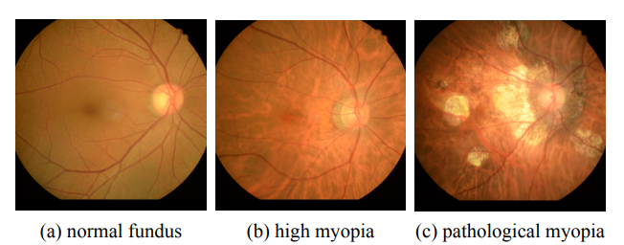

Slide 4
MOTIVATION
To develop the Automatic Detection of Pathological Myopia and High Myopia system, we were motivated by our visit to a hospital where we spoke with an eye specialist. She provided us with valuable information about the condition, explaining the diagnostic process, and treatment options available. We observed how the specialist used lenses and other diagnostic tools to evaluate patients’ eye conditions, which highlighted the limitations of manual diagnosis. This interaction made us realize the importance of developing an automated system that could assist specialists by providing an accurate and efficient tool for detecting myopia. Our aim is to create a system that can support medical professionals, enhancing both diagnostic accuracy and accessibility for patients.

Slide 5
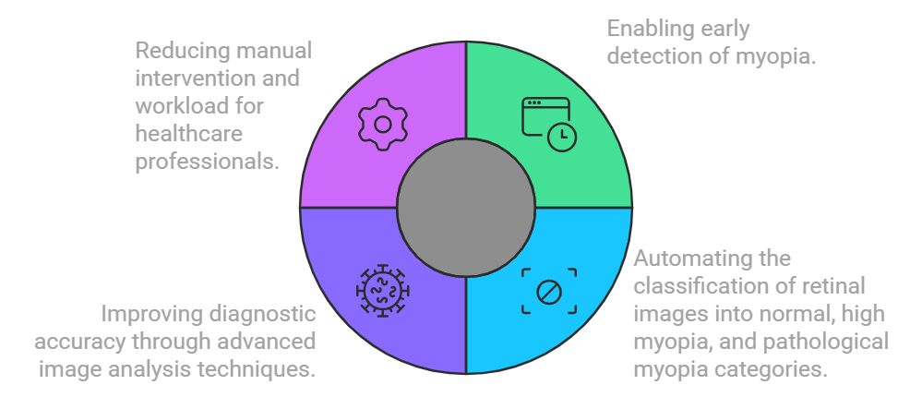
OBJECTIVE

Slide 6
PROBLEM STATEMENT
Early & automatic detection of Pathological myopia and high myopia from fundus images by developing a computer-based system or algorithm that can identify and classify cases of pathological myopia and high myopia from fundus images.

Slide 7
LITERATURE SURVEY
Title | Publication | Author | Details
Deep Learning in Image Classification using Dense Networks and Residual Networks for Pathologic Myopia Detection . | 78-1-6654-0890-5/21/$31.00 ©2021 IEEE | DOI: 10.1109/ICAIBDA53487.2021.9689744 | Zein Rasyid Himami , Alhadi Bustamam, Prasnurzaki Anki . | This work aimed to detect pathologic myopia in retinal fundus images using deep learning models like ResNet-50 and DenseNet-201. The ODIR dataset, consisting of 612 fundus images, was split into training, validation, and testing sets. DenseNet with the Adam optimizer achieved the best results, with 97% accuracy, 93% sensitivity, and 100% specificity. Limitation - Limited dataset size, which may impact the model's generalization ability. Dependence on high-quality images for optimal accuracy.

Slide 8
Title | Publication | Author | Details
Pathologic Myopia Detection and Visualization Based on Multi-Scale Deep Features by PMnet Tuned with Cyclic Learning Rate Hyper parameter. | 8th International Conference on Computing in Engineering and Technology (ICCET 2023) Patna, India 14–15 July 20238th International Conference on Computing in Engineering and Technology (ICCET 2023) Patna, India 14–15 July 2023 | Pammi Kumari1 , Priyank Saxena. | This study proposed PMnet, a CNN designed to identify and visualize pathologic myopia. Using an autoencoder for feature extraction and PMnet for classification, the model was optimized with a Cyclic Learning Rate (CLR) for faster accuracy. A saliency heatmap highlighted affected areas in the 1985-image dataset. PMnet outperformed ResNet-50, achieving 81.82% accuracy. Limitation - The proposed work is limited to binary classification because of the need for a labeled dataset for Pathologic Myopia grading.

Slide 9
Title | Publication | Author | Details
Detection And Classification Of ‘Myopia Epidemic’ Using Image Processing And Machine Learning To Prevent Fatal Road Accidents. | 2023 14th International Conference on Computing Communication and Networking Technologies (ICCCNT) | 979-8-3503-3509-5/23/$31.00 ©2023 IEEE | DOI: 10.1109/ICCCNT56998.2023.10307490 | A.E. Narayanan, M.Ishwarya , S.KaviarasanM.Praveen, N.Sagana. | The study aimed to detect myopia in drivers to reduce road accidents caused by visual impairment. Using 3D stereoscopy, eye images were converted to fundus images for analysis, with texture features extracted through GLCM and GLRLM techniques. A CNN classified the images into myopic and non-myopic groups, and corrective measures like surgery or glasses were recommended to enhance road safety. The accuracy 93% during the planning stage and 97% throughout testing . Limitation - For accurate results, high-quality input photos are essential. Difficulty in accurately detecting mild cases of myopia

Slide 10
Title | Publication | Author | Details
Automatic Diagnosis of Cataract and Myopia Through Fundus Images | 79-8-3503-3564-4/23/$31.00 ©2023 IEEE | DOI: 10.1109/ICBATS57792.2023.10111388 | Wajeeha Ahmed , Bisma Shahid, Nauman Aziz , Farheen Afzal , Abd Ur Rehman , Dr Fareeha Zafar | This project used transfer learning with ResNet-18 and ResNet-50 models to automate the detection of cataracts and myopia in fundus images, aiming for early diagnosis. The dataset, with 3398 images, was divided into cataract, myopia, and normal categories. After pre-processing and modifying the models' final layers, ResNet-18 achieved 98.9% accuracy, and ResNet-50 reached 97.8%. Limitation - The model's accuracy is highly dependent on the quality of input fundus images. It performs binary classification without grading the severity of myopia or cataract.

Slide 11
Title | Publication | Author | Details
Automatic screening of pathological myopia using deep learning | 2023 29th International Conference on Mechatronics and Machine Vision in Practice (M2VIP) | 979-8-3503-2562-1/23/$31.00 ©2023 IEEE | DOI: 10.1109/M2VIP58386.2023.10413411 | Haonan Qin , Wei Zhang , Xiujuan Zhao | The project developed a system to detect pathological myopia (PM) from fundus images using CNNs with Transfer and Ensemble Learning. Trained on 3,796 fundus images, it combined lightweight and larger networks, achieving 99.87% accuracy, 99.52% sensitivity, and 100% specificity. This AI tool shows great potential for assisting ophthalmologists in early PM detection and improving patient care. Limitation - The system is limited to Pathological Myopia (PM) and does not address other myopia types. Performance can be affected by inconsistencies in fundus image quality and equipment​.

Slide 12
Title | Publication | Author | Details
Automatic Detection Of Pathological Myopia And High Myopia On Fundus Images | 978-1-7281-1331-9/20/$31.00 c 2020 IEEE | Siying Dai, Leiting Chen, Ting Lei, Chuan Zhou , Yang Wen | This study used ResNet-18 with Binary Cross-Entropy and Triplet Loss functions to diagnose normal, high, and pathologic myopia from fundus images. A two-branch network first classified images as normal or abnormal, then differentiated between high and pathologic myopia. Trained on a private dataset of 932 images, the model showed high accuracy (81.82%), improving the speed and precision of clinical diagnosis. Limitation- The classification depends on a customized loss function combining Binary Cross-Entropy and Triplet Loss, which may not generalize to other tasks or datasets. Difficulty in Distinguishing PM and HM .

Slide 13
SYSTEM REQUIREMENTS SPECIFICATION
Software Requirements :-
Coding Language - Python
Operating System – Windows 10
Platform – Anaconda Navigator
Database - SQLite
Hardware Requirements :-
Processor – Pentium-IV
Ram – 512 MB
Hard Disk – 40GB
Key Boards – Standard Windows Keyboard

Slide 14
FUNCTIONAL REQUIREMENTS
User Registration: Users must register using their personal information. Once registered, the administrator verifies their identity and grants them access to the system.
CNN Algorithm For Detection: The method employs CNN to evaluate fundus pictures and identify myopia via image classification.
Data Loading: The system will import and process picture datasets for analysis.

Slide 15
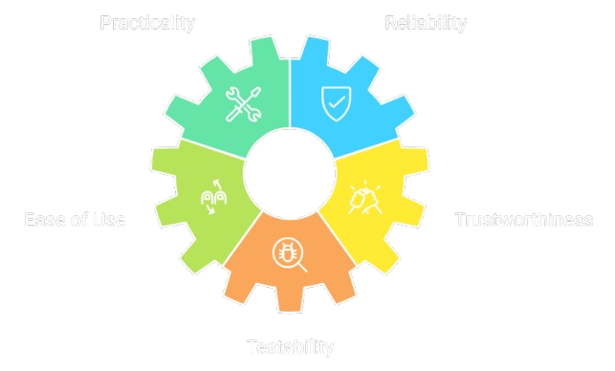
NON FUNCTIONAL REQUIREMENTS
( Software is designed for easy maintenance and troubleshooting.)
( Software's performance is high, ensuring consistent and reliable result.)
( User interface is intuitive and easy to navigate.)
( Software maintains data integrity and controls unauthorized access.)
( Software undergoes thorough testing to ensure quality and functionality. )

Slide 16
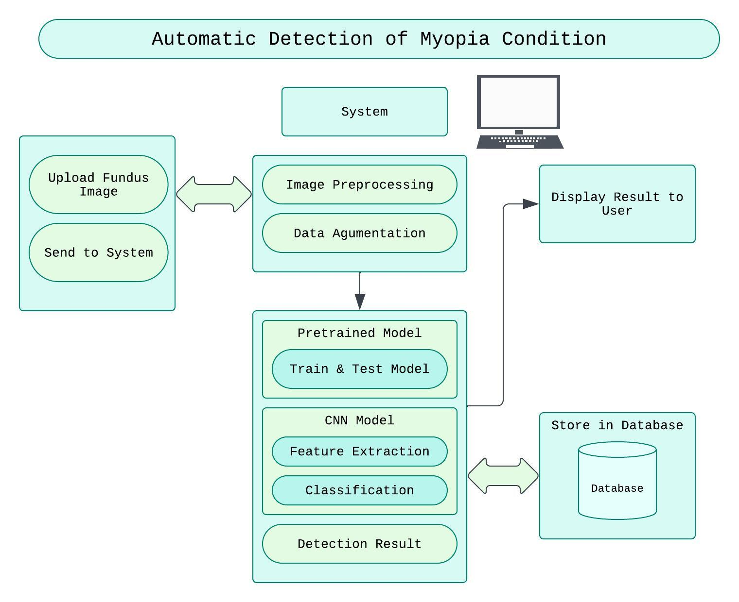
SYSTEM ARCHITECTURE

Slide 17
Components of the System Architecture
Input and Preprocessing: The system accepts retinal images (fundus pictures) and processes them by removing noise, resizing, and adjusting color contrast for clearer analysis.
Data Augmentation: This is used to increase the diversity of training data by applying transformations (like rotation, flipping, scaling) to improve model generalization and prevent overfitting.
Feature Extraction: Key features like optic disc parameters, retinal thickness, and blood vessel patterns are automatically extracted to identify signs of myopia.
CNN Classification: A trained Convolutional Neural Network (CNN) classifies the images into normal fundus, high myopia, or pathological myopia, based on the extracted features.
Output Display: The system predicts the severity of myopia and displays results to the user, aiding in diagnosis and treatment decisions.
Database Storage: The system stores user information and classification results in a secure database for future reference and analysis.

Slide 18
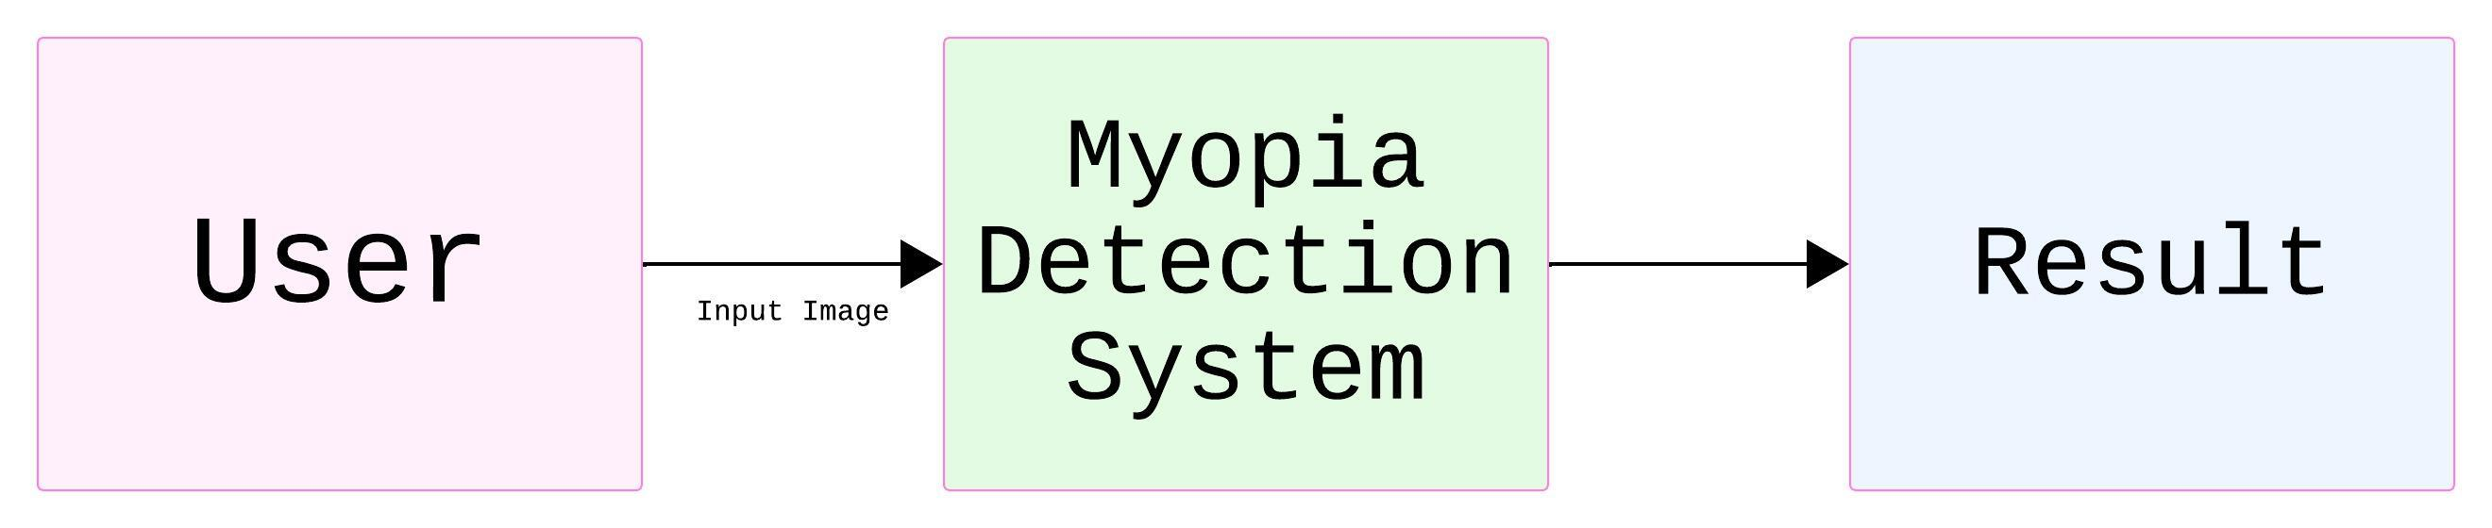
DATA FLOW DIAGRAM
DFD 0

Slide 19
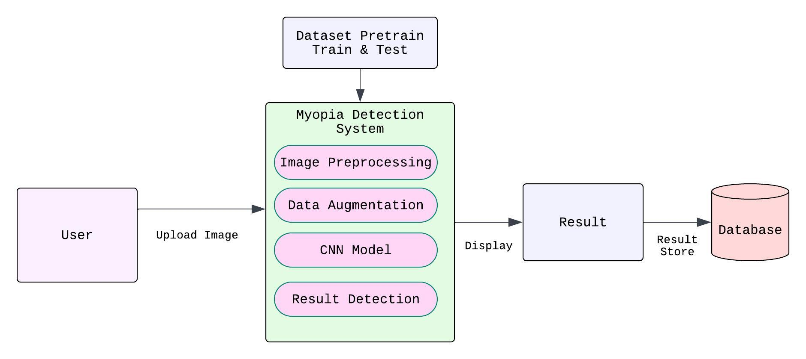
DFD 1

Slide 20
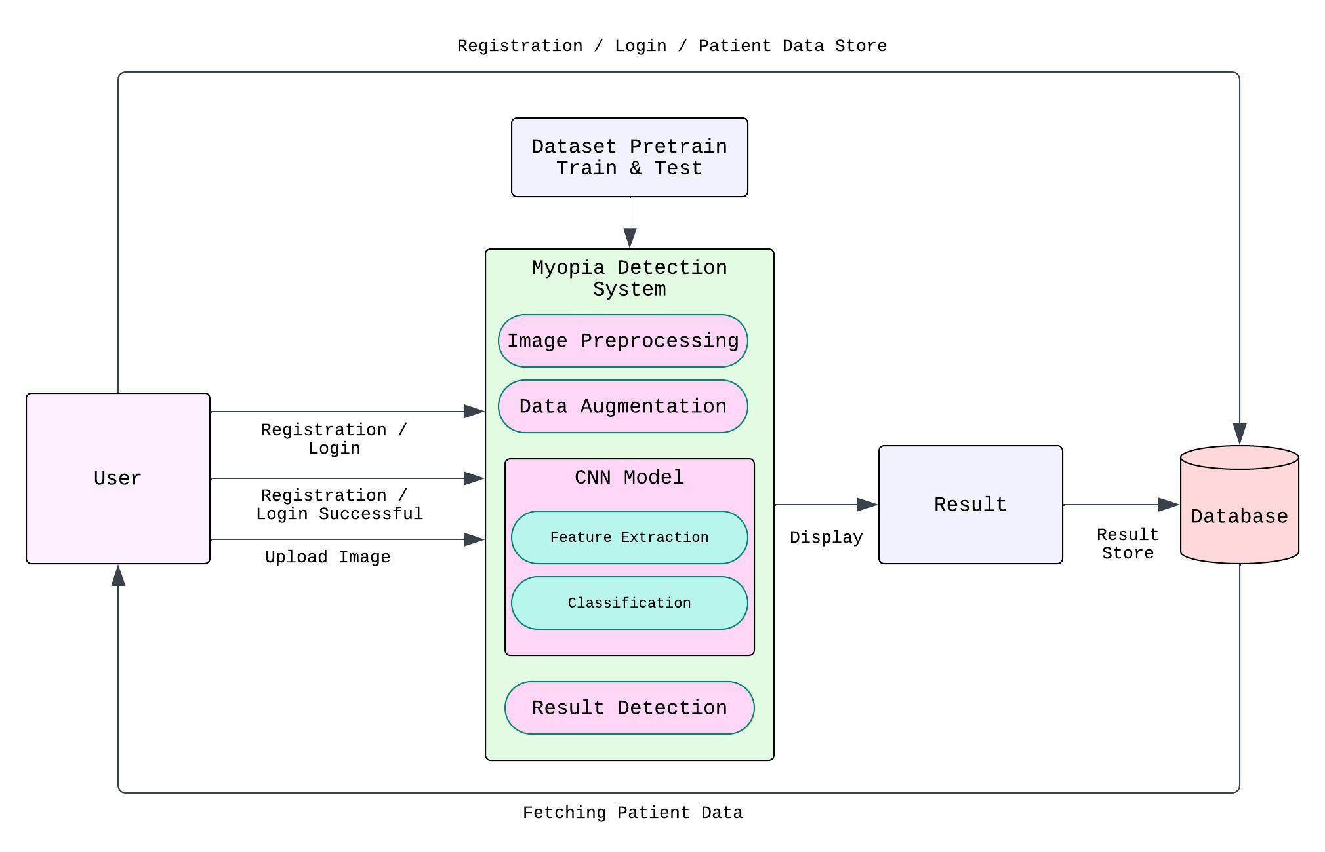
DFD 2

Slide 21
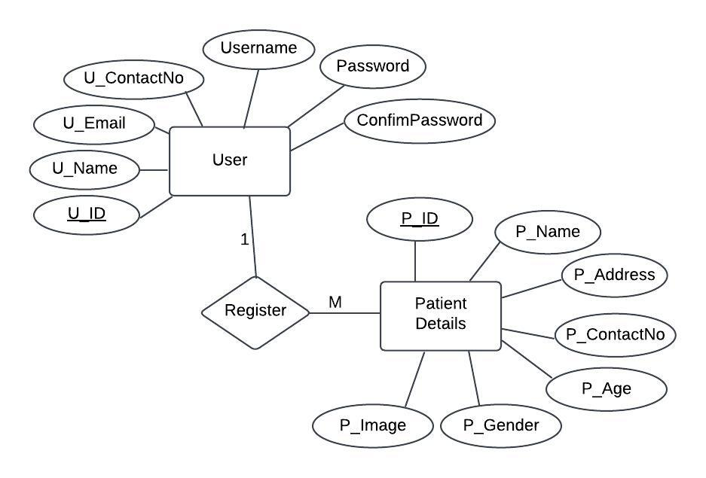
ENTITY RELATIONSHIP DIAGRAM

Slide 22
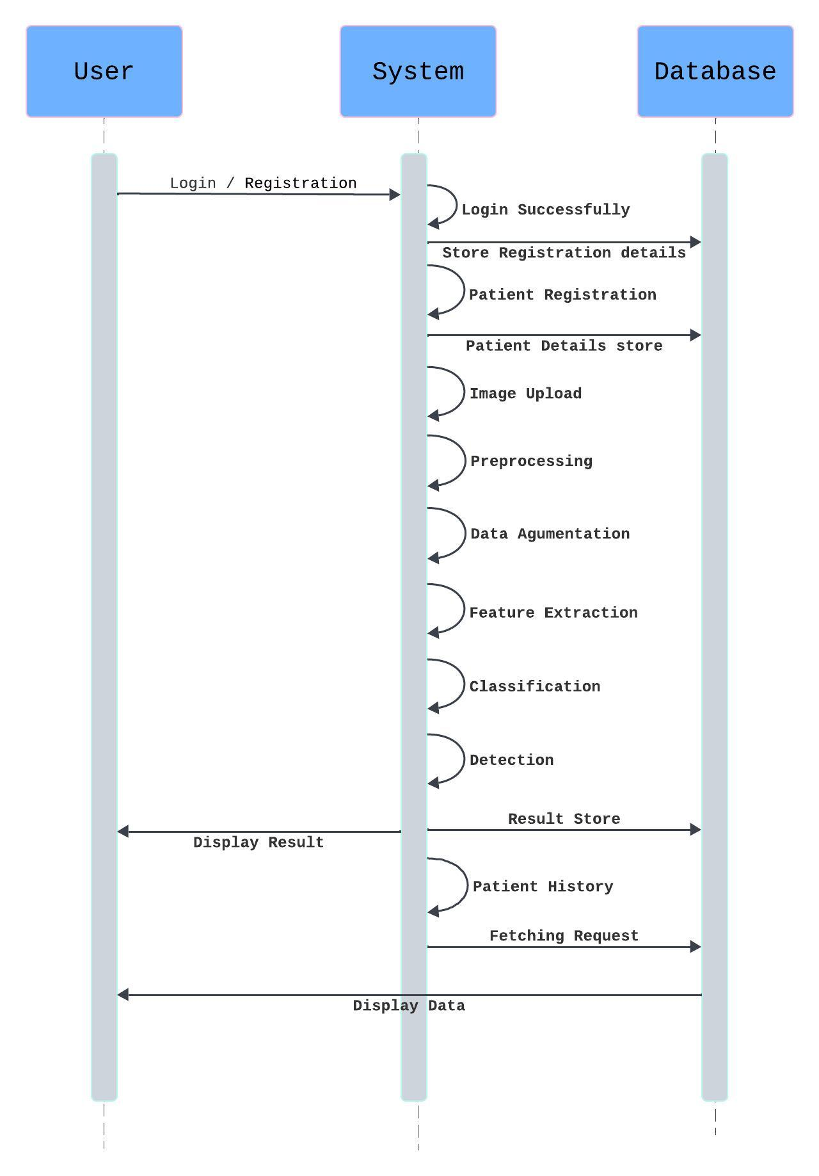
SEQUENCE DIAGRAM

Slide 23
System Implementation
Algorithm - CNN Algorithm. Model Used - Convolutional Neural network (CNN) Model
Dataset Information - Contain the 2310 images
Normal images – 770
Pathological Myopia Images – 770
High Myopia – 770

Slide 24
MODULE
Frontend Module: User interface for uploading fundus images and viewing results.
Image Upload: Allows users to upload retinal images, validating file type and size.
Image Preprocessing: Enhances image quality through contrast adjustment and noise reduction.
Data Augmentation: This is used to increase the diversity of training data by applying transformations (like rotation, flipping, scaling) .
Feature Extraction: Extracts key retinal features like optic disc shape and retinal thickness.
Classification of Pathological Myopia (PM), High Myopia (HM) & Normal: CNN model classifies images into normal, pathological myopia, or high myopia.
Detection of Category: Identifies the category of myopia using extracted features.
Result Display: Displays classification results .
Result Storage: Stores the images and classification results for future analysis.

Slide 25
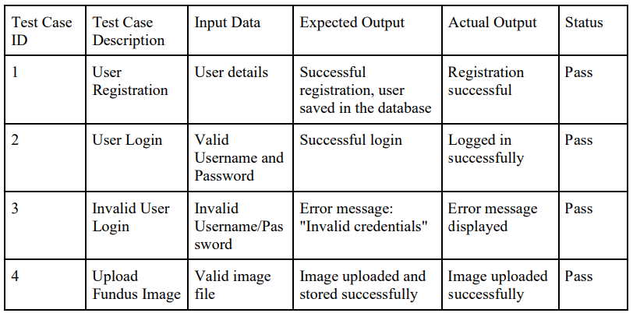
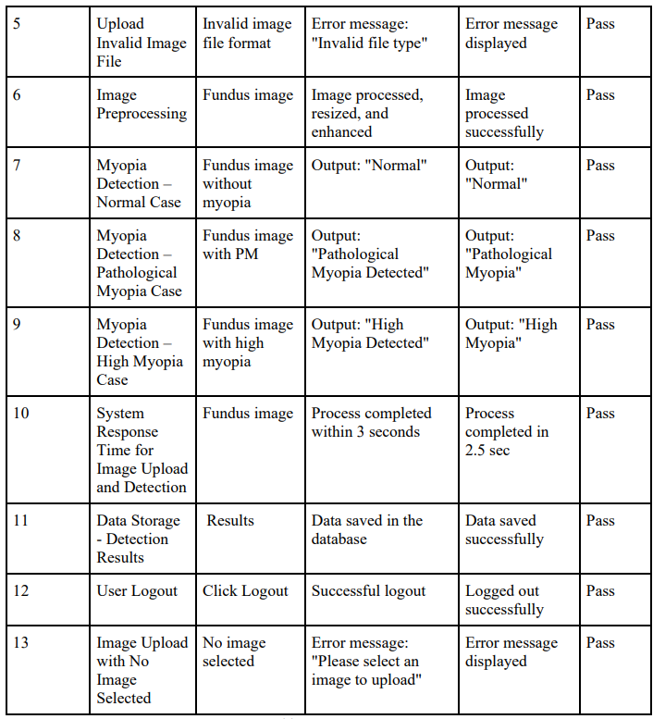
Test Cases

Slide 27
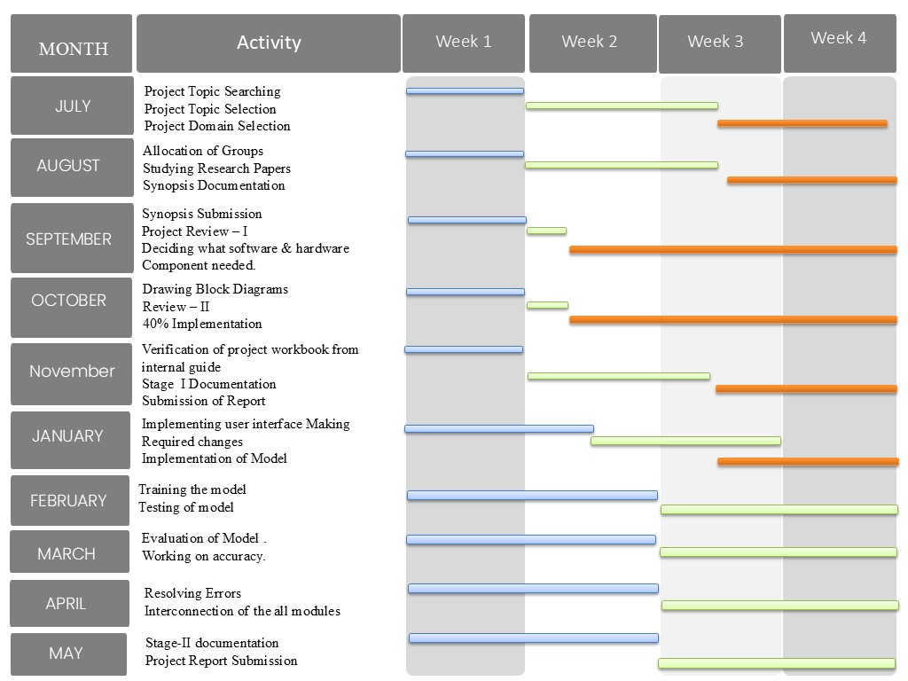
PROJECT PLAN

Slide 28
CONCLUSION
This project will be developed an automated system for detecting pathological and high myopia using fundus images and Convolutional Neural Networks (CNNs). The system improves diagnostic accuracy by classifying images into normal, pathological, or high myopia categories, allowing for early detection and intervention. It reduces manual effort, enhances efficiency, and provides a user-friendly tool for healthcare professionals, demonstrating the potential in addressing myopia-related vision issues.

Slide 29
References
[1] Zein Rasyid Himami , Alhadi Bustamam , Prasnurzaki Anki “ Deep Learning in Image Classification using Dense Networks and Residual Networks for Pathologic Myopia Detection ” 78-1-6654-0890-5/21/$31.00 ©2021 IEEE | DOI: 10.1109/ICAIBDA53487.2021.9689744
[2] Pammi Kumari1 , PriyankSaxena “PathologicMyopia Detection and Visualization Based on Multi-Scale Deep Features by PMnet Tuned with Cyclic Learning Rate Hyperparameter “ 8th International Conference on Computing in Engineering and Technology (ICCET 2023) Patna, India 14–15 July 2023
[3] A.E Narayanan , M. Ishwarya , S. Kaviarasan ,M. Praveen4, N. Sagana “DETECTION AND CLASSIFICATION OF ‘MYOPIA EPIDEMIC’ USING IMAGE PROCESSING AND MACHINE LEARNING TO PREVENT FATAL ROAD ACCIDENTS ” 2023 14th International Conference on Computing Communication and Networking Technologies (ICCCNT) | 979-8-3503-3509-5/23/$31.00 ©2023 IEEE | DOI: 10.1109/ICCCNT56998.2023.10307490
[4] Wajeeha Ahmed , Bisma Shahid , Nauman Aziz , Farheen Afzal , Abd Ur Rehman , Dr Fareeha Zafar “Automatic Diagnosis of Cataract and Myopia Through Fundus Images ” 79-8-3503-3564-4/23/$31.00 ©2023 IEEE | DOI: 10.1109/ICBATS57792.2023.10111388
[5] Haonan Qin , Wei Zhang , Xiujuan Zhao “ Automatic screening of pathological myopia using deep learning ” 2023 29th International Conference on Mechatronics and Machine Vision in Practice (M2VIP) | 979-8-3503-2562-1/23/$31.00 ©2023 IEEE | DOI: 10.1109/M2VIP58386.2023.10413411
[6] Siying Dai, Leiting Chen, Ting Lei, Chuan Zhou , Yang Wen “ AUTOMATIC DETECTION OF PATHOLOGICAL MYOPIA AND HIGH MYOPIA ON FUNDUS IMAGES ” 978-1-7281-1331-9/20/$31.00 c 2020 IEEE

Slide 30
Thank You

